Slide 1
Chapter 8
Scheduling Resources

Slide 2
The Resource Problem
Resources and Priorities
  Project network times are not a schedule until resources have been assigned.
    The implicit assumption is that resources will be available in the required amounts when needed.
    Adding new projects requires making realistic judgments of resource availability and project durations.
Resource-Constrained Scheduling
  Resource leveling (or smoothing) involves attempting to even out demands on resources by using slack (delaying noncritical activities) to manage resource utilization.
Copyright © 2006 The McGraw-Hill Companies. All rights reserved.
McGraw-Hill/Irwin 8–<number>

Slide 3
Types of Project Constraints
Technical or Logic Constraints
  Constraints related to the networked sequence in which project activities must occur.
Physical Constraints
  Activities that cannot occur in parallel or are affected by contractual or environmental conditions.
Resource Constraints
  The absence, shortage, or unique interrelationship and interaction characteristics of resources that require a particular sequencing of project activities.
Copyright © 2006 The McGraw-Hill Companies. All rights reserved.
McGraw-Hill/Irwin 8–<number>

Slide 4
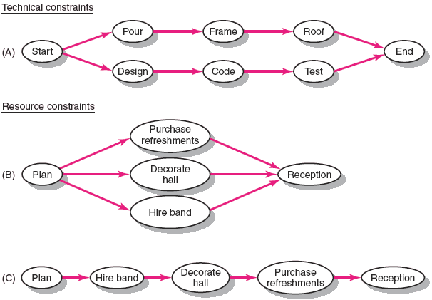
Constraint Examples
FIGURE 8.1
Copyright © 2006 The McGraw-Hill Companies. All rights reserved.
McGraw-Hill/Irwin 8–<number>

Slide 5

Kinds of Resource Constraints
People
Materials
Equipment
Working Capital
Copyright © 2006 The McGraw-Hill Companies. All rights reserved.
McGraw-Hill/Irwin 8–<number>

Slide 6
Classification of A Scheduling Problem
Classification of Problem
  Using a priority matrix will help determine if the project is time or resource constrained.
Time Constrained Project
  A project that must be completed by an imposed date.
    Time is fixed, resources are flexible: additional resources are required to ensure project meets schedule.
Resource Constrained Project
  A project in which the level of resources available cannot be exceeded.
    Resources are fixed, time is flexible: inadequate resources will delay the project.
Copyright © 2006 The McGraw-Hill Companies. All rights reserved.
McGraw-Hill/Irwin 8–<number>

Slide 7
Resource Allocation Methods
Limiting Assumptions
  Splitting activities is not allowed—once an activity is start, it is carried to completion.
  Level of resource used for an activity cannot be changed.
  Activities with the most slack pose the least risk.
  Reduction of flexibility does not increase risk.
  The nature of an activity (easy, complex) doesn’t increase risk.
Copyright © 2006 The McGraw-Hill Companies. All rights reserved.
McGraw-Hill/Irwin 8–<number>

Slide 8
Resource Allocation Methods (cont’d)
Time-Constrained Projects
  Projects that must be completed by an imposed date.
  Require the use of leveling techniques that focus on balancing or smoothing resource demands by using positive slack (delaying noncritical activities) to manage resource utilization over the duration of the project.
    Peak resource demands are reduced.
    Resources over the life of the project are reduced.
    Fluctuation in resource demand is minimized.
Copyright © 2006 The McGraw-Hill Companies. All rights reserved.
McGraw-Hill/Irwin 8–<number>

Slide 9
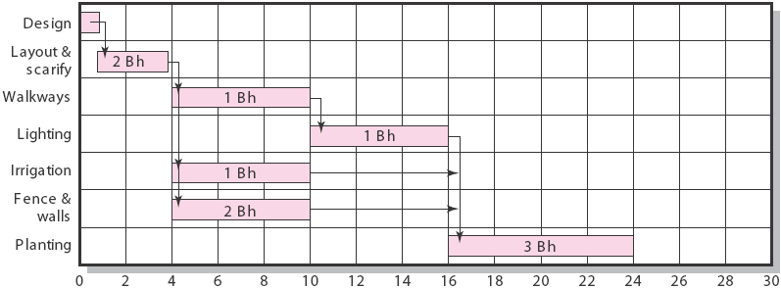
Botanical Garden
FIGURE 8.2
Copyright © 2006 The McGraw-Hill Companies. All rights reserved.
McGraw-Hill/Irwin 8–<number>

Slide 10
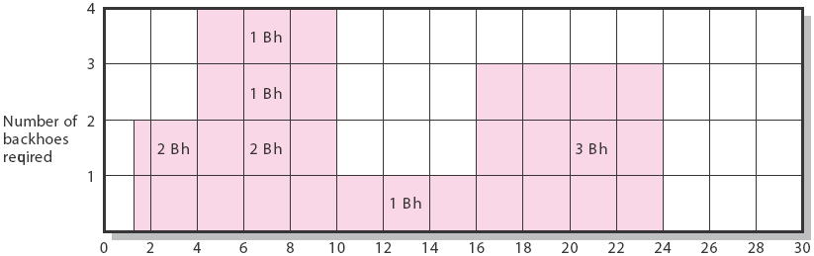
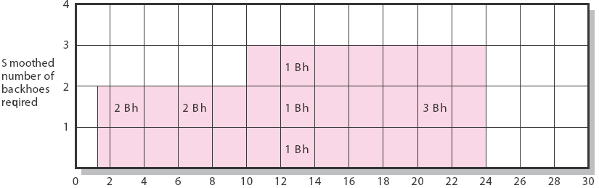
Botanical Garden (cont’d)
FIGURE 8.2 (cont’d)
Copyright © 2006 The McGraw-Hill Companies. All rights reserved.
McGraw-Hill/Irwin 8–<number>

Slide 11
Resource Allocation Methods (cont’d)
Resource Demand Leveling Techniques for Time-Constrained Projects
  Advantages
    Peak resource demands are reduced.
    Resources over the life of the project are reduced.
    Fluctuation in resource demand is minimized.
  Disadvantages
    Loss of flexibility that occurs from reducing slack.
    Increases in the criticality of all activities.
Copyright © 2006 The McGraw-Hill Companies. All rights reserved.
McGraw-Hill/Irwin 8–<number>

Slide 12
Resource Allocation Methods (cont’d)
Resource-Constrained Projects
  Projects that involve resources that are limited in quantity or by their availability.
  Scheduling of activities requires the use of heuristics (rules-of-thumb) that focus on:
    Minimum slack
    Smallest (least) duration
    Lowest activity identification number
  The parallel method is used to apply heuristics
    An iterative process that starts at the first time period of the project and schedules period-by-period any activities scheduled to start using the three priority rules.
Copyright © 2006 The McGraw-Hill Companies. All rights reserved.
McGraw-Hill/Irwin 8–<number>

Slide 13
Computer Demonstration of Resource-Constrained Scheduling
EMR Project
  The development of a handheld electronic medical reference guide to be used by emergency medical technicians and paramedics.
Problem
  There are only eight design engineers who can be assigned to the project due to a shortage of design engineers and commitments to other projects.
Copyright © 2006 The McGraw-Hill Companies. All rights reserved.
McGraw-Hill/Irwin 8–<number>

Slide 14
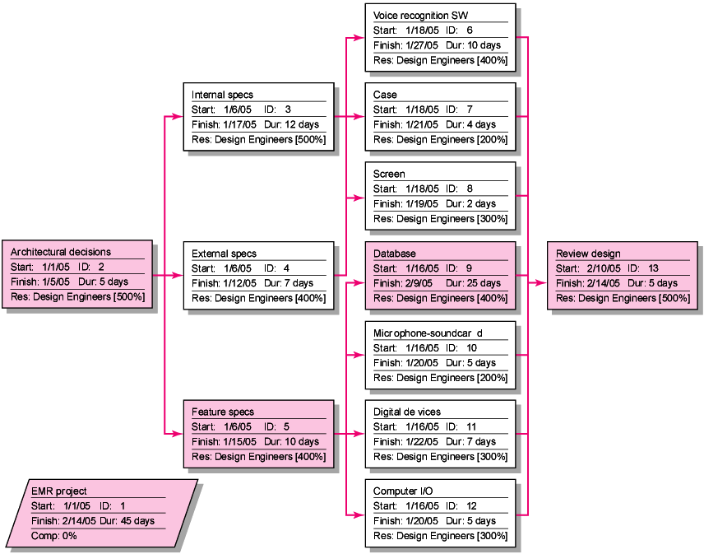
EMR Project: Network View of Schedule before Resources Leveled
FIGURE 8.5
Copyright © 2006 The McGraw-Hill Companies. All rights reserved.
McGraw-Hill/Irwin 8–<number>

Slide 15
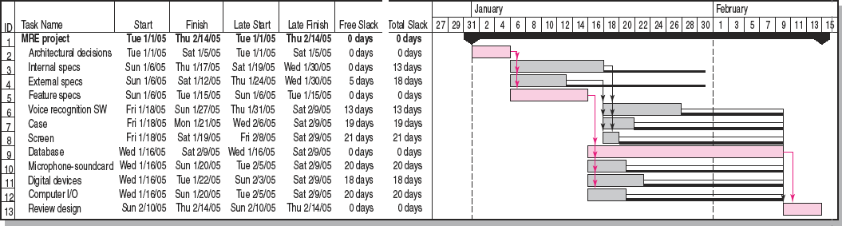

EMR Project before Resources Added
FIGURE 8.6
Copyright © 2006 The McGraw-Hill Companies. All rights reserved.
McGraw-Hill/Irwin 8–<number>

Slide 16
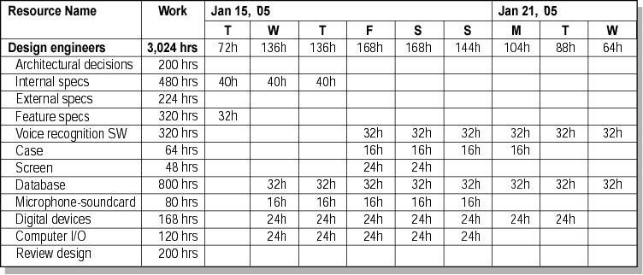
EMR Project—Time Constrained Resource Usage View, January 15–23, 2005
FIGURE 8.7A
Copyright © 2006 The McGraw-Hill Companies. All rights reserved.
McGraw-Hill/Irwin 8–<number>

Slide 17
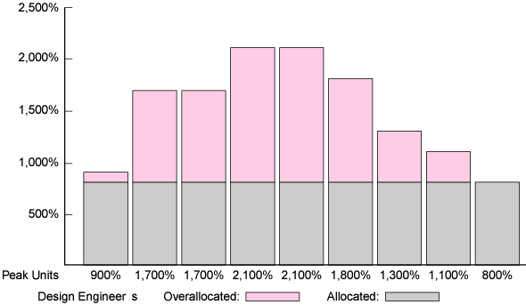
Resource Loading Chart for EMR Project,
January 15–23, 2005
FIGURE 8.A7B
Copyright © 2006 The McGraw-Hill Companies. All rights reserved.
McGraw-Hill/Irwin 8–<number>

Slide 18
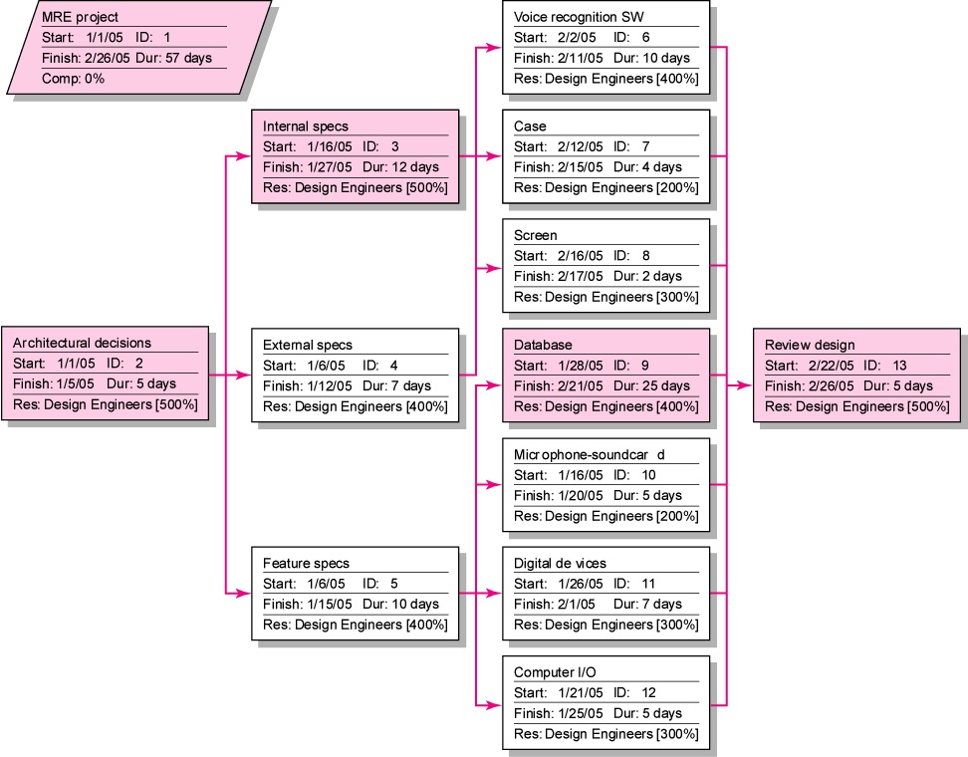
EMR Project Network View Schedule
after Resources Leveled
FIGURE 8.8
Copyright © 2006 The McGraw-Hill Companies. All rights reserved.
McGraw-Hill/Irwin 8–<number>

Slide 19
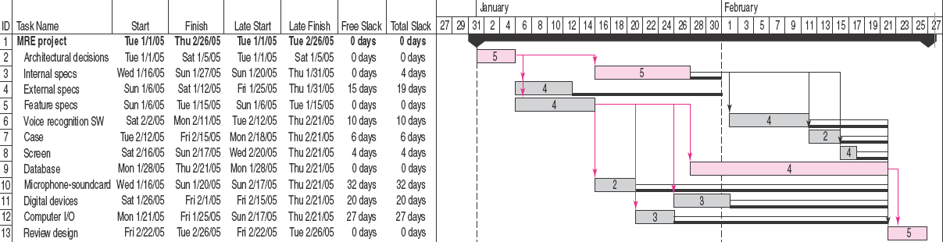

EMR Project Resources Leveled
FIGURE 8.9
Copyright © 2006 The McGraw-Hill Companies. All rights reserved.
McGraw-Hill/Irwin 8–<number>

Slide 20
The Impacts of Resource-Constrained Scheduling
Reduces delay but reduces flexibility.
Increases criticality of events.
Increases scheduling complexity.
May make traditional critical path no longer meaningful.
Can break sequence of events.
May cause parallel activities to become sequential and critical activities with slack to become noncritical.
Copyright © 2006 The McGraw-Hill Companies. All rights reserved.
McGraw-Hill/Irwin 8–<number>

Slide 21
Splitting/Multitasking
Splitting/Multitasking
  A scheduling technique use to get a better project schedule and/or increase resource utilization.
    Involves interrupting work on an activity to employ the resource on another activity, then returning the resource to finish the interrupted work.
    Is feasible when startup and shutdown costs are low.
    Is considered the major reason why projects fail to meet schedule.
Copyright © 2006 The McGraw-Hill Companies. All rights reserved.
McGraw-Hill/Irwin 8–<number>

Slide 22
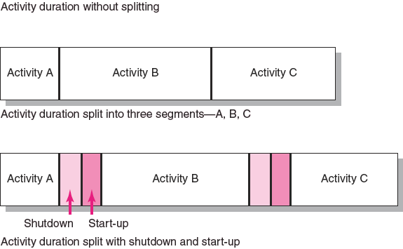
Splitting/Multitasking
FIGURE 8.10
Copyright © 2006 The McGraw-Hill Companies. All rights reserved.
McGraw-Hill/Irwin 8–<number>

Slide 23
Assigning Project Work
Factors to Consider in Assigning Work:
  Don’t always pick the same people for the toughest assignments.
  Choose people with an eye to fostering their development through participation on the project.
  Pick people with compatible work habits and personalities but who complement each other.
  Team-up veterans with new hires to share experience and socialize newcomers into the organization.
  Select people who may need to learn work together on later stages of the project or other projects.
Copyright © 2006 The McGraw-Hill Companies. All rights reserved.
McGraw-Hill/Irwin 8–<number>

Slide 24
Multiproject Resource Schedules
Multiproject Scheduling Problems
  Overall project slippage
    Delay on one project create delays for other projects
  Inefficient resource application
    The peaks and valleys of resource demands create scheduling problems and delays for projects.
  Resource bottlenecks
    Shortages of critical resources required for multiple projects cause delays and schedule extensions.
Copyright © 2006 The McGraw-Hill Companies. All rights reserved.
McGraw-Hill/Irwin 8–<number>

Slide 25
Multiproject Resource Schedules
Managing Multiproject Scheduling
  Create project offices or departments to oversee the scheduling of resources across projects.
  Use a project priority queuing system: first come, first served for resources.
  Centralize project management: treat all projects as a part of a “megaproject.”
  Outsource projects to reduce the number of projects handled internally.
Copyright © 2006 The McGraw-Hill Companies. All rights reserved.
McGraw-Hill/Irwin 8–<number>

